Slide 1
The IceBreaker

Slide 2
Objective:
In this section you will learn:
Artificial Intelligence v/s Machine Learning v/s Deep Learning
Data Science and Data Analytics
Applications of Machine Learning and Deep Learning
What is Machine Learning?
What to learn in Machine Learning?
Supervised, Unsupervised and Reinforcement learning
Classification and Regression
Clustering, Anomaly detection, recommendation system and Dimensionality reduction
What is Deep Learning.
Where Deep Learning fails?

Slide 3
Artificial Intelligence

Slide 4
What is Artificial Intelligence?
“The capability of a machine to imitate intelligent human behavior“
Notes:
the theory and development of computer systems able to perform tasks normally requiring human intelligence, such as visual perception, speech recognition, decision-making, and translation between languages

Slide 5
Early 1950 Optimism began
Artificial Intelligence
1980’s Machine Learning begins to flourish
Machine Learning
2010 Deep Learning breakthroughs
Deep Learning

Slide 6
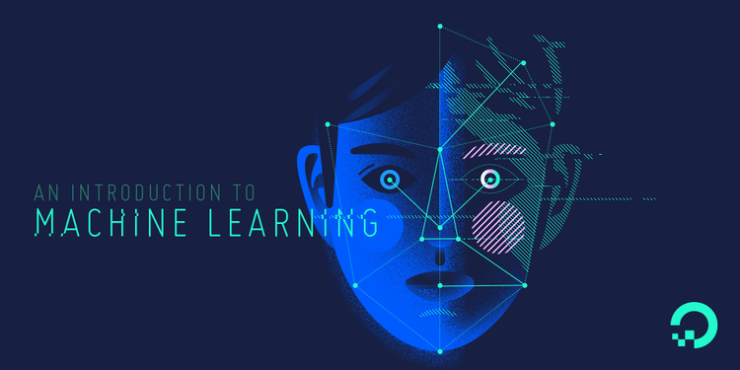

Slide 7

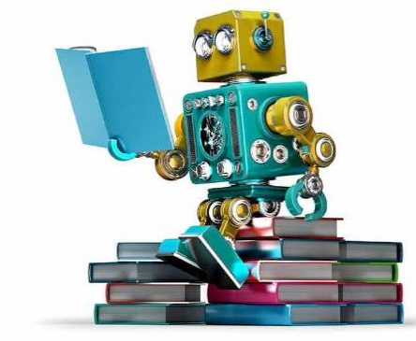
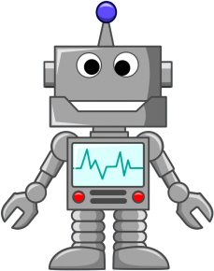

Slide 8
Machine learning is a field of computer science that gives computers the ability to learn without being explicitly programmed.
—Arthur Samuel, 1959

Slide 9
“Classical” decision making
(explicit instructions)
Requires ‘a priori’ knowledge
Feature | Input | Procedure | Output
F0 | [0.8] | if F1 > 0.5 and F2 * F3 < 0.3: if (F4 – F5) / F6 < 1: do A else: if F7 * F0 < 0.3: do B else: do C else: do D | “A”
F1 | [0.2]
F2 | [0.9] |  | “B”
F3 | [0.2]
F4 | [0.0] |  | “C”
F5 | [0.4]
F6 | [0.3] |  | “D”
F7 | [0.1]

Slide 10
ML decision making
Requires no (or very little) ‘a priori’ knowledge
Feature | Input | Procedure | Output
F0 | [0.8] | Output = MATRIX * Input (Linear Regression) Output = g( M2 * f( M1 * Input) ) (Neural Network with one hidden layer) | “A”
F1 | [0.2]
F2 | [0.9] |  | “B”
F3 | [0.2]
F4 | [0.0] |  | “C”
F5 | [0.4]
F6 | [0.3] |  | “D”
F7 | [0.1]

Slide 11
Applications of Machine Learning
Financial Predictions, Fraud Detections
Loan Approval
Data Mining – Web Click Data, Medical Records, Diagnosis
Predictive Maintenance
Ad plus user information
Computer Vision – Face Recognition, Self Driving Cars, OCR
Churn Prediction, Customer Segmentation, Sales Forecasting
Voice recognition, Chatbots, Sentiment Analysis, Machine Translation

Slide 12
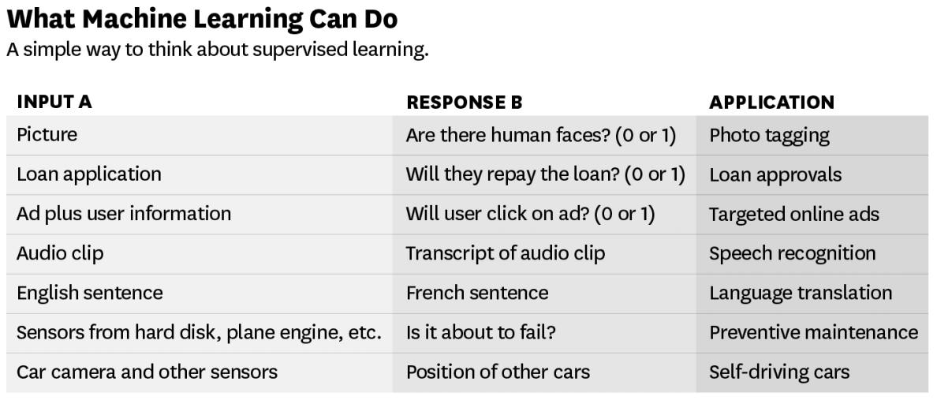
Source – ANDREW NG

Slide 13
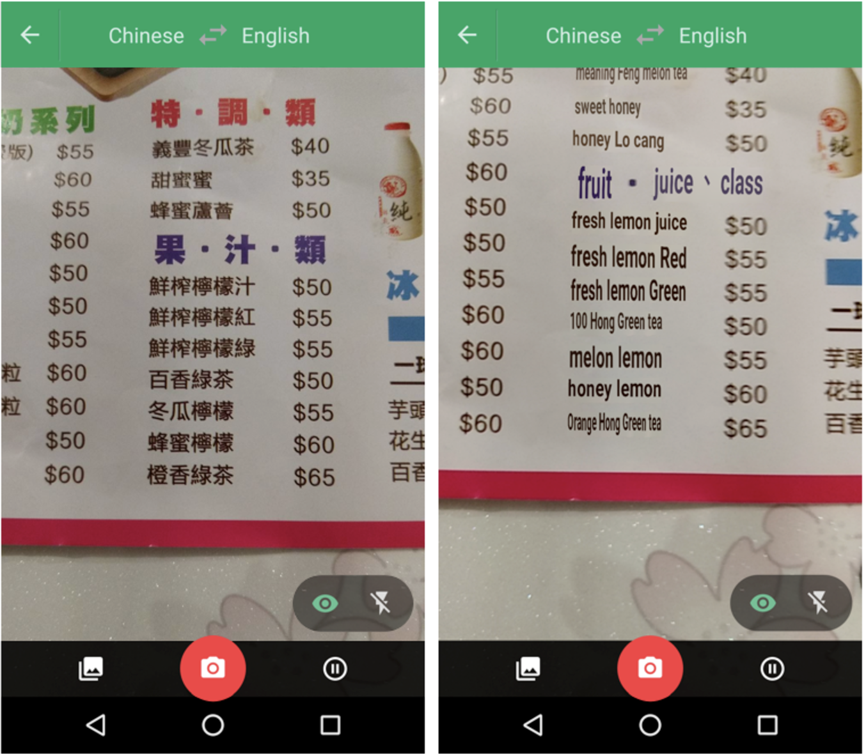
!!
Point your camera at the menu during your next trip to Taiwan and the restaurant’s selections will magically appear in English via the Google Translate app.
Google Translate overlaying English translations on a drink menu in real time using convolutional neural networks.

Slide 14
Manufacturing | Retail | Financial Services
Predictive maintenance or condition monitoring Warranty reserve estimation Propensity to buy Demand forecasting Process optimization Telematics | Predictive inventory planning Recommendation engines Upsell and cross-channel marketing Market segmentation and targeting Customer ROI and lifetime value | Risk Analytics and Regulations Customer Segmentation Cross-selling and up-selling Sales and marketing campaign management Credit worthiness evaluation
Travel and Hospitability | Health Care and Life Sciences | Energy, Feedstock and Utility
Aircraft scheduling Dynamic pricing Social media — consumer feedback and interaction analysis Customer complaint resolution Traffic patterns and congestion management | Alerts and diagnostics from real-time patient data Disease identification and risk stratification Patient triage optimization Proactive health management Healthcare provider sentiment analysis | Power usage analytics Seismic data processing Carbon emissions and trading Customer-specific pricing Smart grid management Energy demand and supply optimization

Slide 15
Programming Languages -
Python | R

Slide 16
Machine Learning Cloud Platforms -
Microsoft Azure ML Studio
https://azure.microsoft.com/en-us/services/machine-learning-studio/
Amazon Machine Learning
https://aws.amazon.com/aml/
SAP Leonardo Machine Learning
https://www.sap.com/india/products/leonardo/machine-learning.html
Google ML Platform
https://cloud.google.com/products/machine-learning/
IBM Machine Learning
https://www.ibm.com/analytics/data-science/machine-learning

Slide 17
What to learn in machine Learning?
Programming and
Tools
30%
Python/R, spark etc.
The Math behind
Machine Learning
70%
Probabilistic Theory, Statistics and Linear Algebra

Slide 18
What to learn in Machine Learning?
Python for Machine Learning
Packages for Machine Learning – Tensorflow, keras etc.
Handling Big Data
Practice, practice & practice
Optimization, boosting Techniques
Statistics for Data Science
Math behind Machine Learning Algorithms

Slide 19
Discovering patterns in unlabeled data.
Cluster similar documents based on the text content.
Learning based on feedback or reward.
Learn to play chess by winning or losing.
Learning with a labeled training set.
Email spam detector with training set of already labeled emails.
Supervised Learning
Unsupervised Learning
Reinforcement Learning

Slide 20




Supervised Learning
We know what we are trying to predict. We use some examples that we (and the model) know the answer to, to “train” our model. It can then generate predictions to examples we don’t know the answer to.
Examples: Predict the price a house will sell at. Identify the gender of someone based on a photograph.

Slide 21


Unsupervised Learning
We don’t know what we are trying to predict. We are trying to identify some naturally occurring patterns in the data which may be informative.
Examples: Try to identify “clusters” of customers based on data we have on them

Slide 22
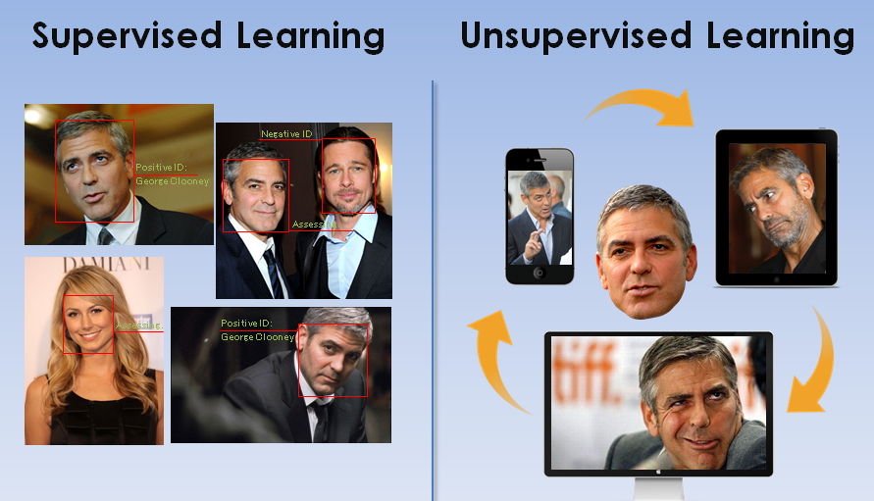

Slide 23
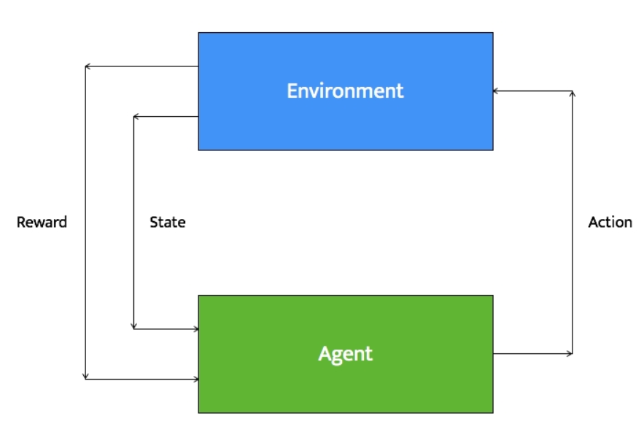
Reinforcement Learning
Reinforcement learning systems can do multiple things simultaneously -- learn by performing a trial and error search, learn the model of the environment it is in, and then use that model to plan the next steps.
Example: Let's consider a robot whose job is to explore a new building. It has to make sure it has enough power left to come back to the base station. This robot has to decide if it should make decisions by considering the trade off between the amount of information collected and the ability to reach back to base station safely.

Slide 24
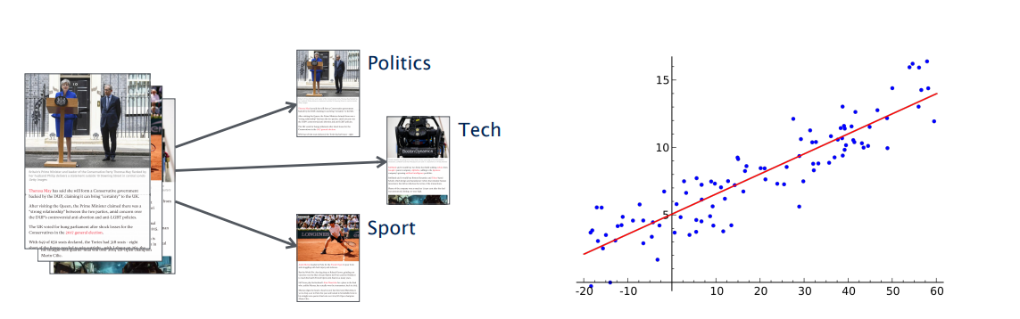
Types of Problems in Supervised Machine Learning -
Classification
(discrete set of possible outcomes)
Regression
(possible outcome can by any numerical value with in a particular continuous range)

Slide 25
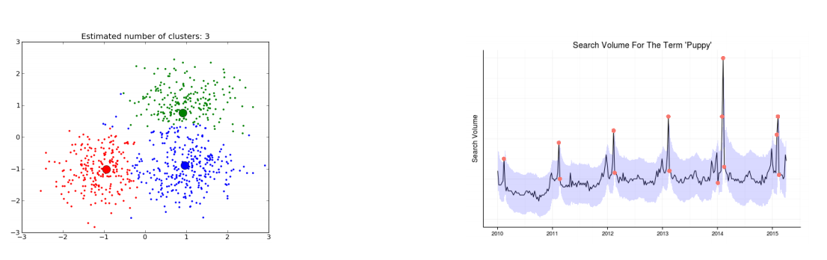
Types of Problems in Unsupervised Machine Learning -
Clustering
(categorization of samples based on similarity in features)
Anomaly Detection
(detecting an anomaly in a general pattern)

Slide 26
Deep Learning

Slide 27
Deep Learning
Deep Learning is part of the machine learning field of learning representations of data. Exceptional effective at learning patterns.

Slide 28
Deep Learning in one slide
What is it:
Extract useful patterns from data.
How:
Neural network + optimization
How (Practical):
Python + TensorFlow & friends
Hard Part:
Good Questions + Good Data
Why now:
Data, hardware, community, tools, investment
Where do we stand?
Most big questions of intelligence have not been answered nor properly formulated
Exciting progress:
Face recognition
Image classification
Speech recognition
Text to speech generation
Handwriting transcription
Machine translation
Medical diagnosis
Cars: drivable area, lane keeping
Digital assistants
Ads, search, social recommendations
Game playing with deep RL

Slide 29
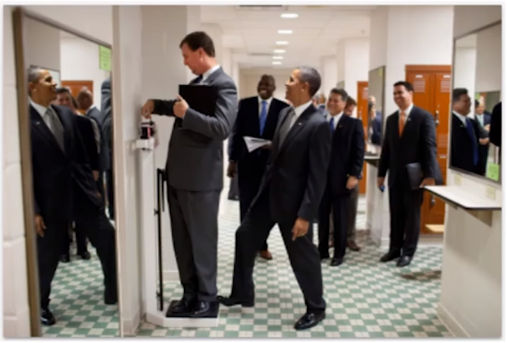
What we can’t do with Deep Learning?
Mirrors
Sparse information
3D Structure
Physics
What’s on peoples’ minds?
What happens next?
Humor

Slide 30
Happy Learning!
Stay Tuned for next exciting sessions on diving deeper into Supervised Learning

